Slide 1

Automation Recipes PAM with RPA
Nigel T. Crowther
Automation Tech Sales EMEA
IBM
IBM Robotic Process Automation
Try it now: https://www.ibm.com/account/reg/ca-en/signup?formid=urx-46597

Slide 2


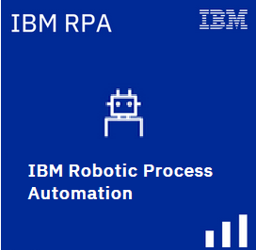
IBM Business Automation Manager Open Editions V8.01
RPA is bundled
Limited to one unattended bot
On prem only
IBM Process Automation Manager Open Edition
IBM Decision Manager
Open Edition
Process Automation and Decision Automation
Decision Automation
Proprietary
Open Source
Notes:
IBM Process Automation Manager Open Edition and IBM Decision Manager Open Edition are fully open-source application development platforms that help clients build highly-customized and scalable cloud-native business automation applications. Clients use Process Automation Manager to model and automate their business processes, including decision automation. They use Decision Manager to focus on decision modeling and automation. Both allow for the rapid development and maintenance of intelligent business automation applications and processes.

Slide 3

Why IBM RPA?
Universal automation glue
Inexpensive
Easy to use
Notes:
IBM Process Automation Manager Open Edition and IBM Decision Manager Open Edition are fully open-source application development platforms that help clients build highly-customized and scalable cloud-native business automation applications. Clients use Process Automation Manager to model and automate their business processes, including decision automation. They use Decision Manager to focus on decision modeling and automation. Both allow for the rapid development and maintenance of intelligent business automation applications and processes.

Slide 4
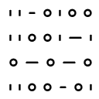








What can bots do?
Use Microsoft Windows
Use file system, clipboard, taskbar, services, open and close applications
Integrate without APIs
Integrate through browsers, remote desktops and terminals
Interact with systems
Access mainframes, call APIs, update and query databases
Communicate
Send and read emails and SMS messages, chat using text and voice
Read documents
Extract structured data from unstructured content
Apply intelligence
Understand information, make decisions, apply knowledge, learn
Create documents
PDF Reports, MS Excel, MS Word
Process Data
Encrypt, analyze, perform calculations
Process Files
Create, upload/download, transfer
Notes:
Robot Process Automation (RPA) is used to automate tasks that are traditionally performed by people, by mimicking the steps that a person would take when performing activities on their desktop computer.
For example, a software robot (or bot) can be created to gather data from multiple systems, collate the data within a spreadsheet, perform some calculations, and enter the data into another system by using the application user interfaces in exactly the same way a person would do it. Bots can also use traditional techniques to integrate with systems, like SQL to query a database or JSON/HTTP to call a REST service.
Other examples include:
Use Microsoft Windows OS - Use file system, clipboard, taskbar, services, open and close applications
Use desktop applications - Work with web apps, Windows apps, Microsoft Office suite, SAP, Java apps, remote desktop
Interact with systems - Access mainframes, call APIs, update and query databases
Communicate - Send and read emails and SMS messages, chat using text and voice
Read documents - Extract structured data from unstructured content
Apply intelligence - Understand information, make decisions, apply knowledge, learn
Create documents - PDF Reports, MS Excel, MS Word
Process Data - Encrypt, analyze, perform calculations
Process Files - Create, upload/download, transfer

Slide 5







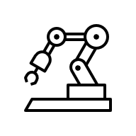
RPA use cases by industry
Banking and insurance
Onboarding
Insurance claims tasks
Loan origination
Energy and utilities
Data collection and reporting
Contracts
Regulations and compliance
IT
Data entry
Capture
Mass email management
Reporting
Data synchronization
Travel and transportation
Vehicle checks and reporting
Travel booking
Healthcare
Medical Appointments
Medical bills
Medical claims tasks
Media and communications
Order management
Provisioning
Government
Benefits processing
Eligibility
Self service updates
Retail industry
Refunds
Procurement
Price comparison
Invoice processing

Slide 6
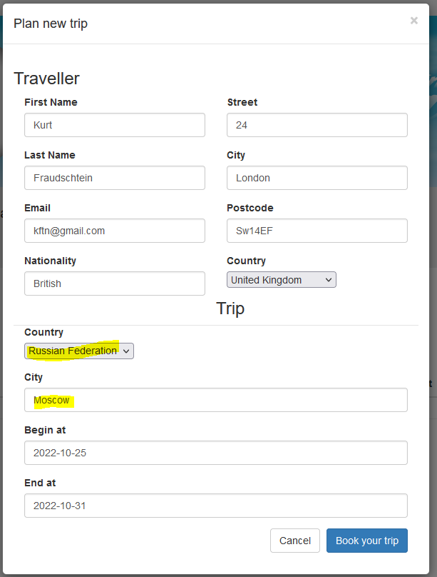
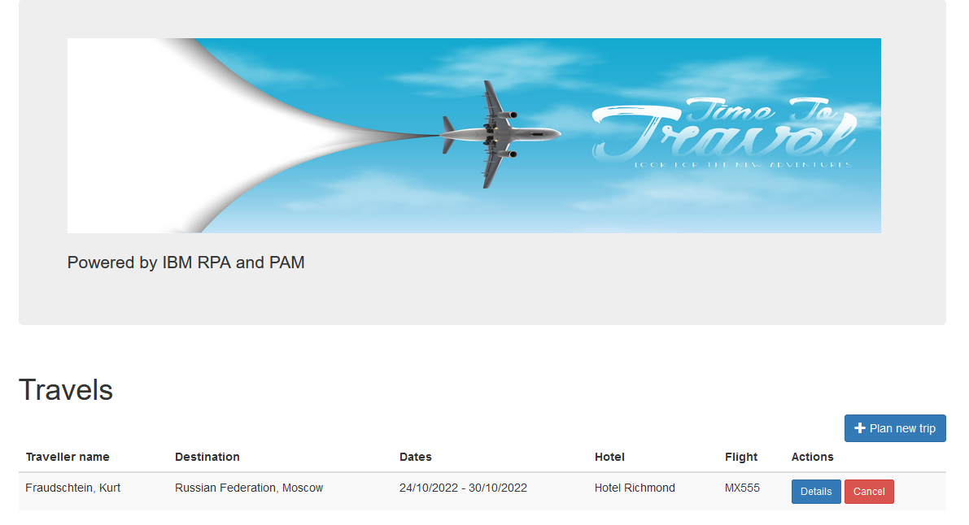
Problem
A travel agency is breaching guidelines by allowing bookings to dangerous countries

Slide 7
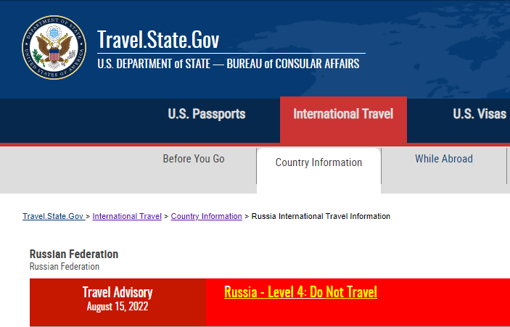
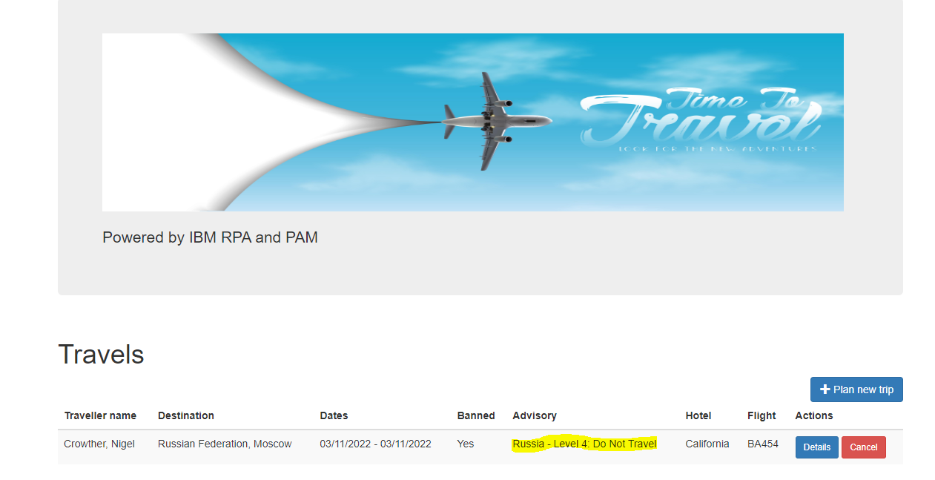
Solution
A bot is written to scrape data from the US Travel site.
The bot is exposed via a secure API
An RPA task is created to call the bot
The PAM flow blocks travel if the bot returns a banned destination
The problem is solved quickly and cost effectively using IBM RPA!

Slide 8
Demo

Slide 9
Step 1: Build the Bot
Using RPA recorder and the low code tools, the bot is built and tested.
The bot has a single input parameter – the destination country
The bot has two output parameters
The travel advisory giving the level of threat
A go/no go flag.

Slide 10
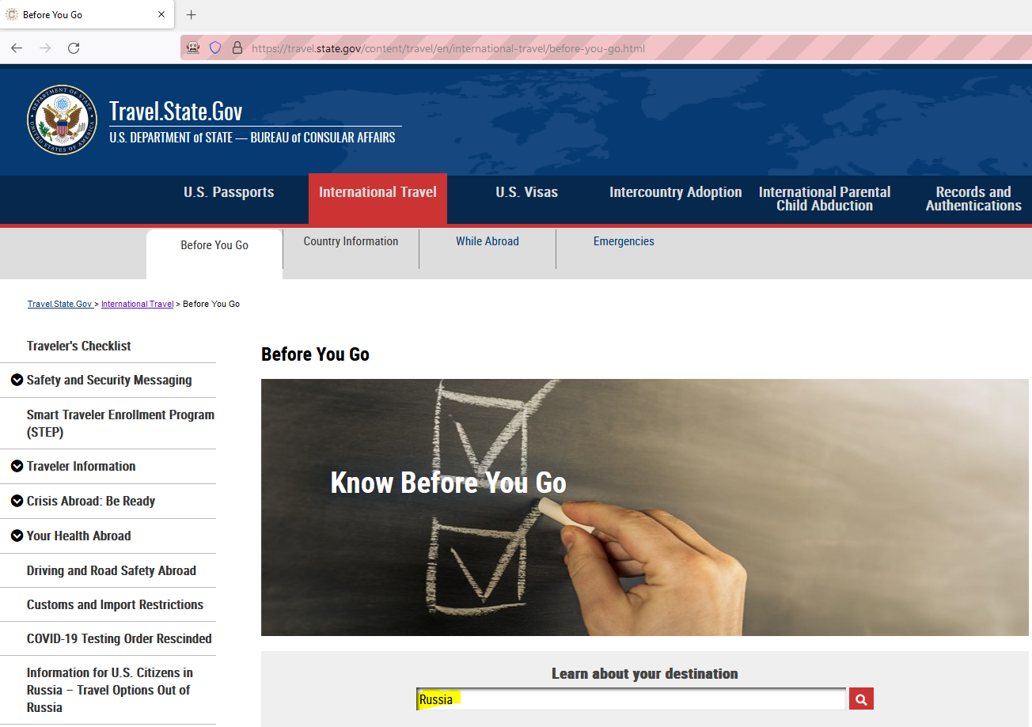
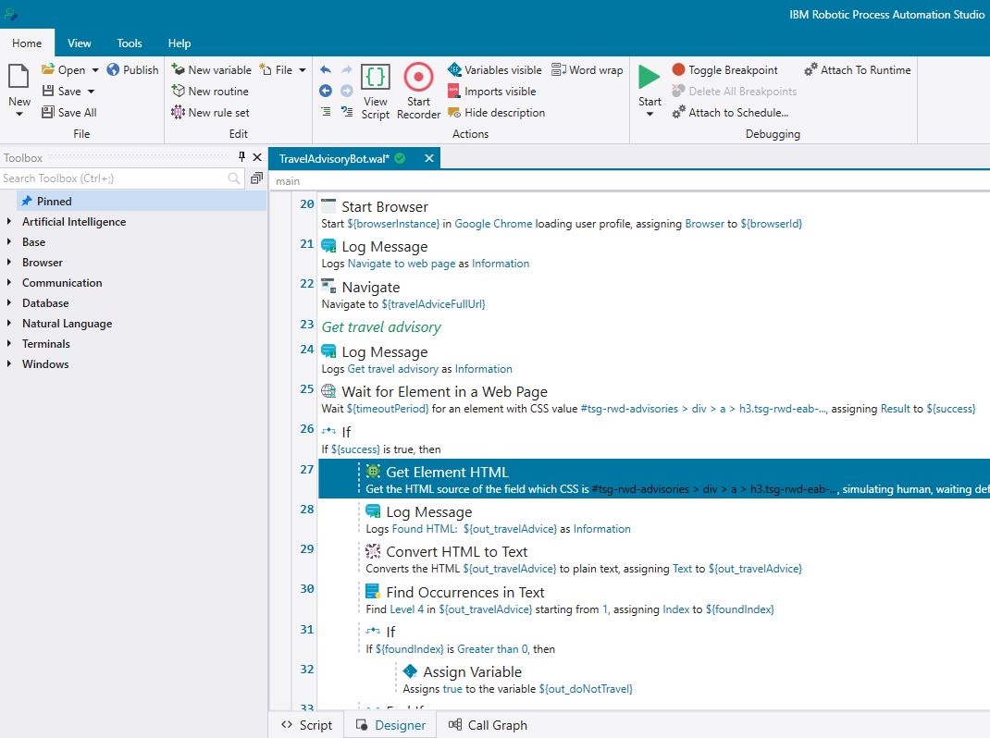
Build the Bot cont.

Slide 11
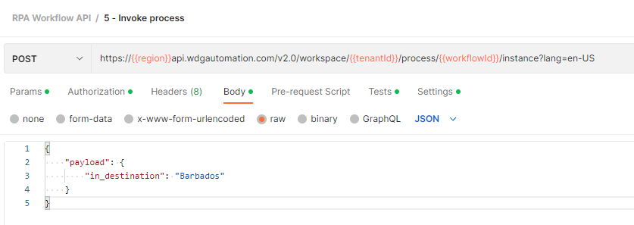
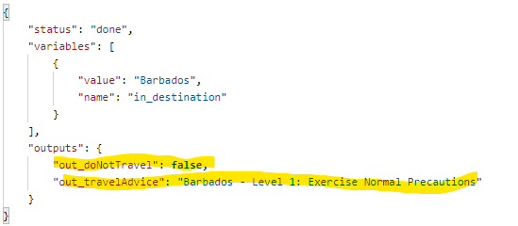
Step 2 – Expose the bot
Exposed via a REST API

Slide 12
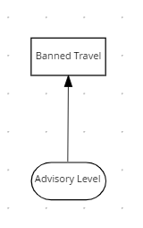
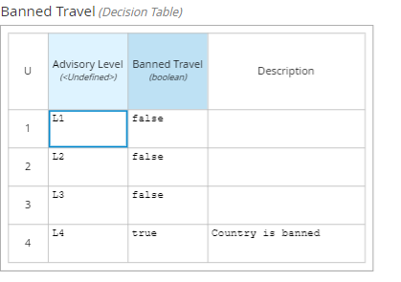
Decision Service

Slide 13
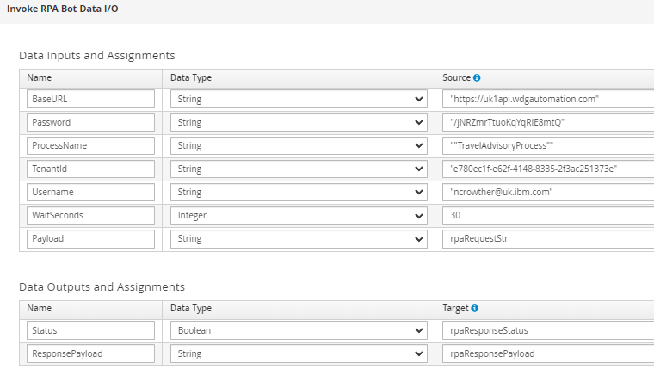
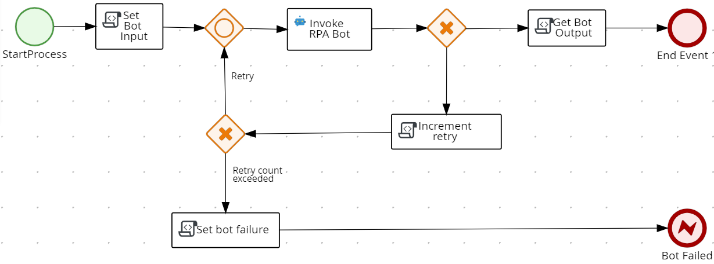
Step 3 – Call the bot from PAM Using a pre-built custom task, the RPA bot invocation is created and tested

Slide 14
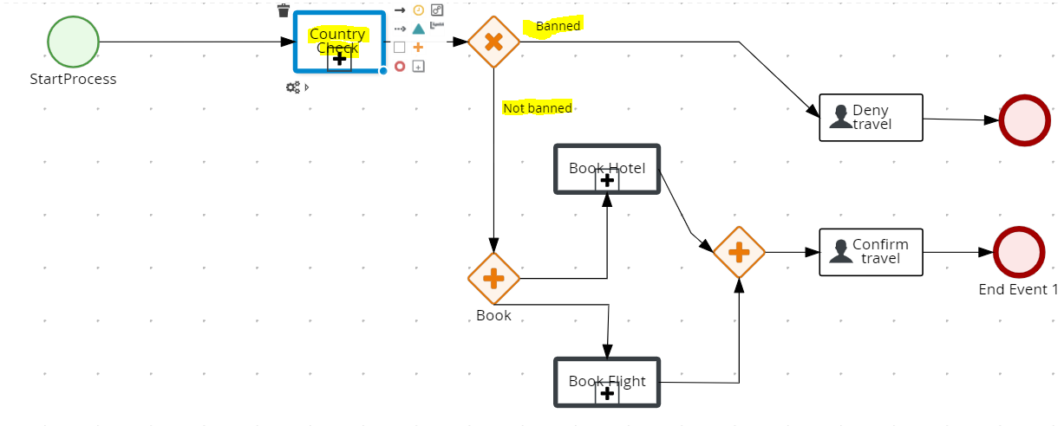
Step 4 – Add to existing flow The flow is plugged into the existing flow. We now have an updated flow that checks the destination and prevents booking if not on the government approved list

Slide 15
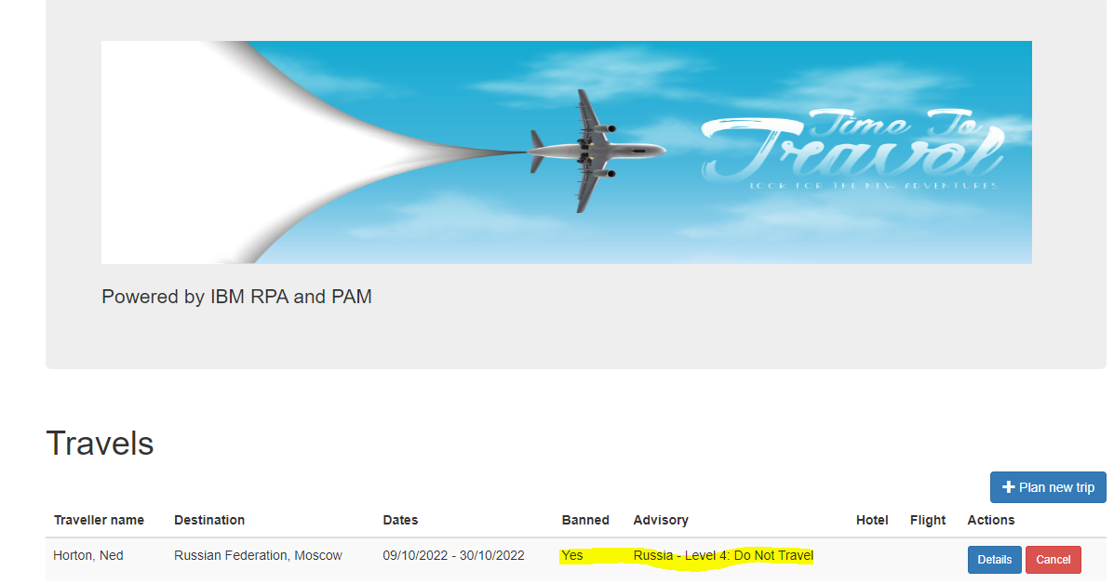
Result – Booking to Banned Country Prevented

